Slide 1
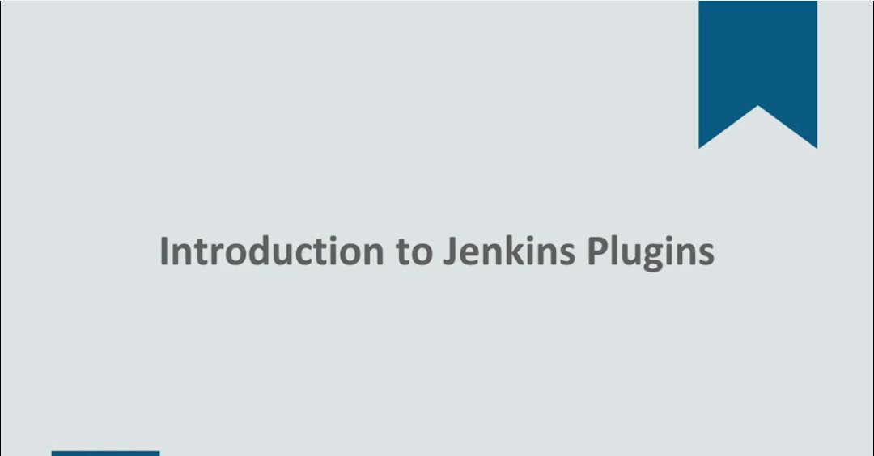

Slide 2
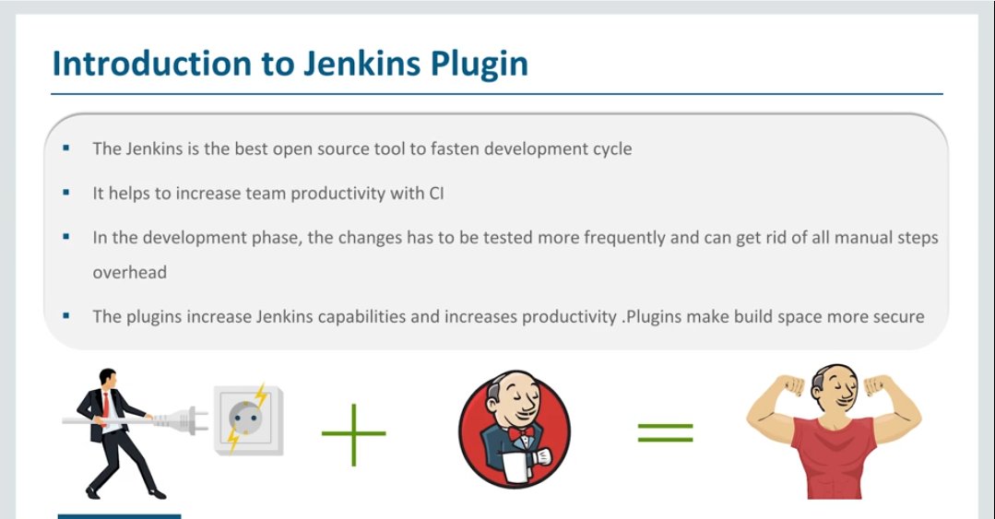

Slide 3
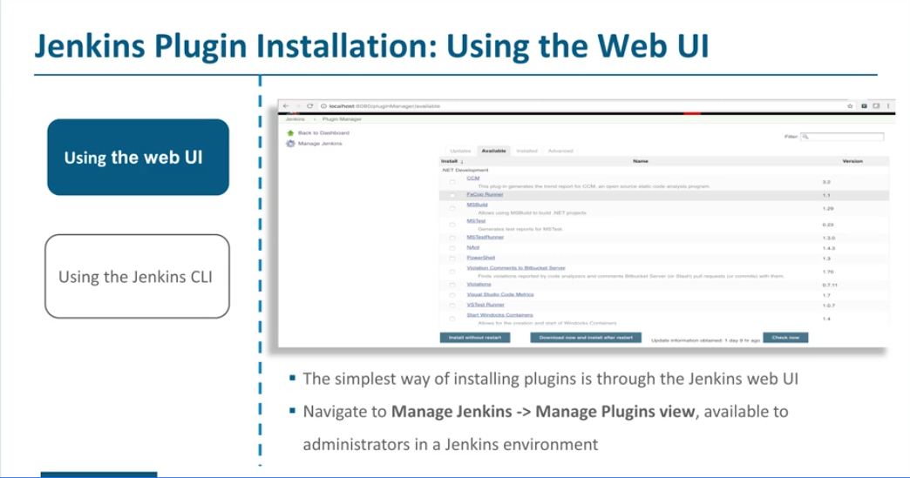

Slide 4
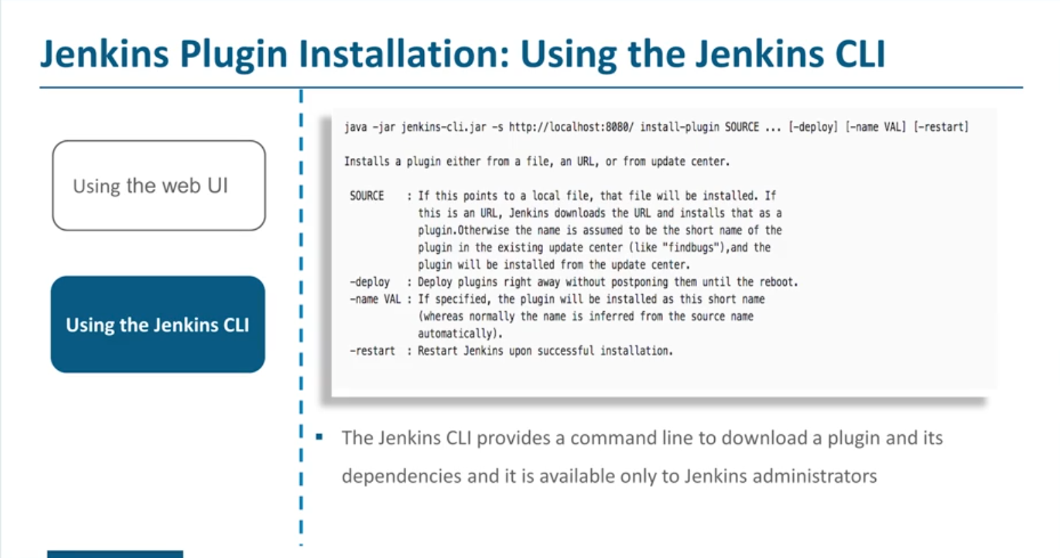

Slide 5
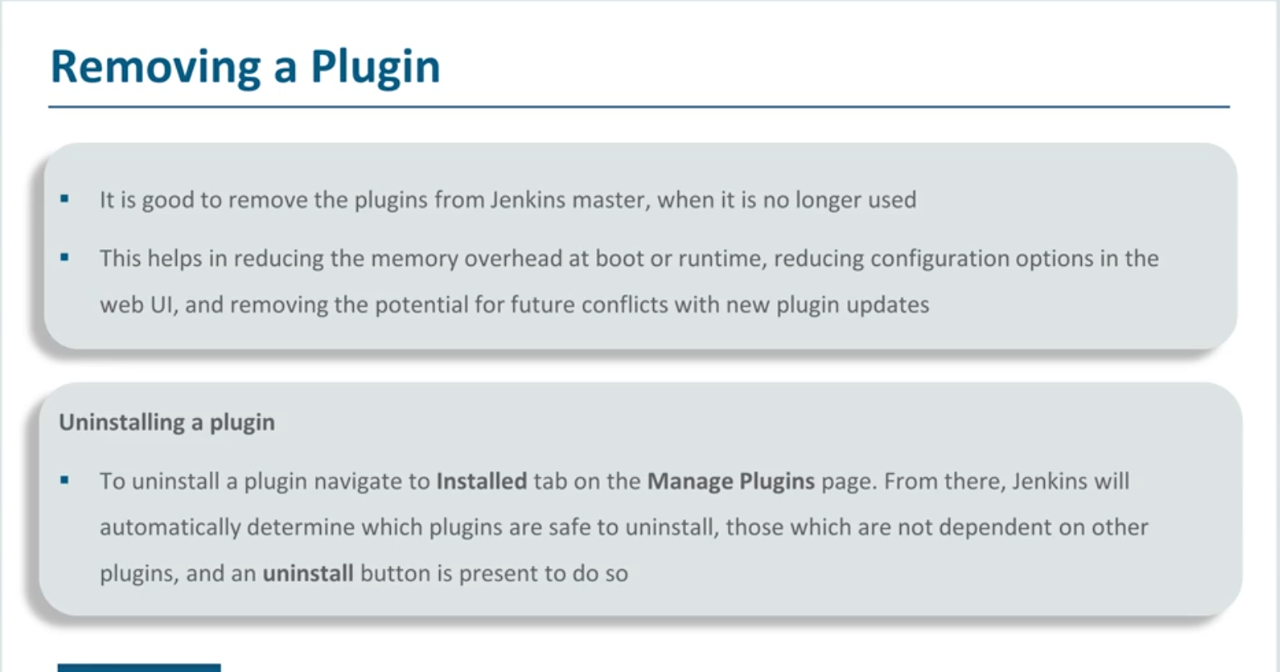

Slide 6
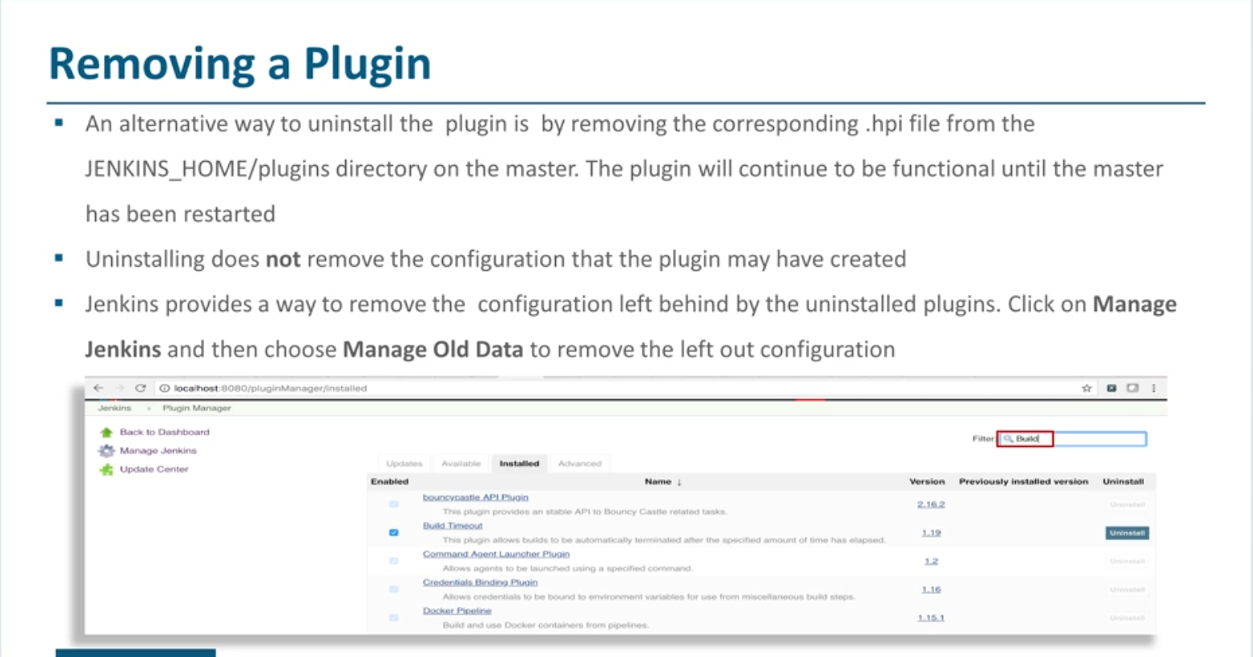

Slide 7
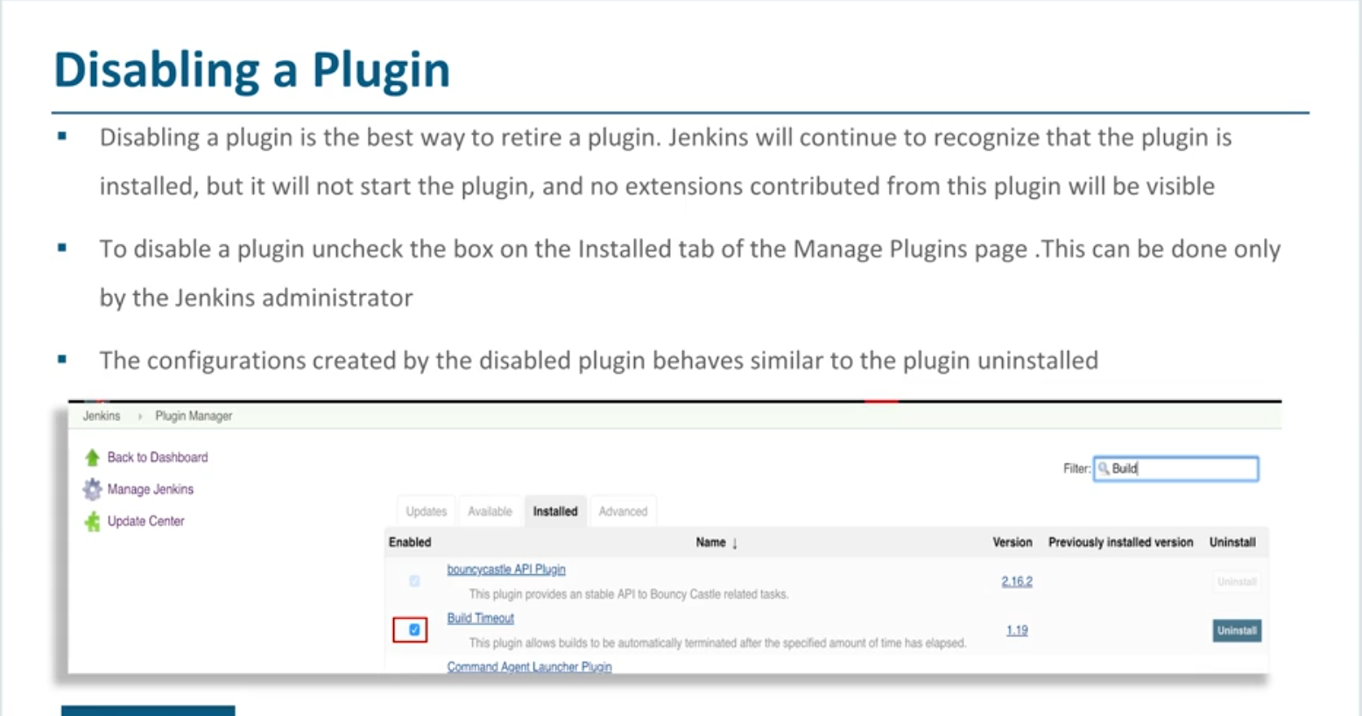

Slide 8
Demo
Manage Jenkins
Manage Plugins
Updates
Available
Installed
Download Now
Install a Plugin
“Azure Container Service”
Plugin + Dependencies
Verify the plugin installation
Create a newItem
Freestyle Project
Ad Build Step
Deploy to Kubernetes
Deploy to Azure CS
Manage Jenkins -> Manage Plugins -> Installed
Verify the uninstallation

Slide 9
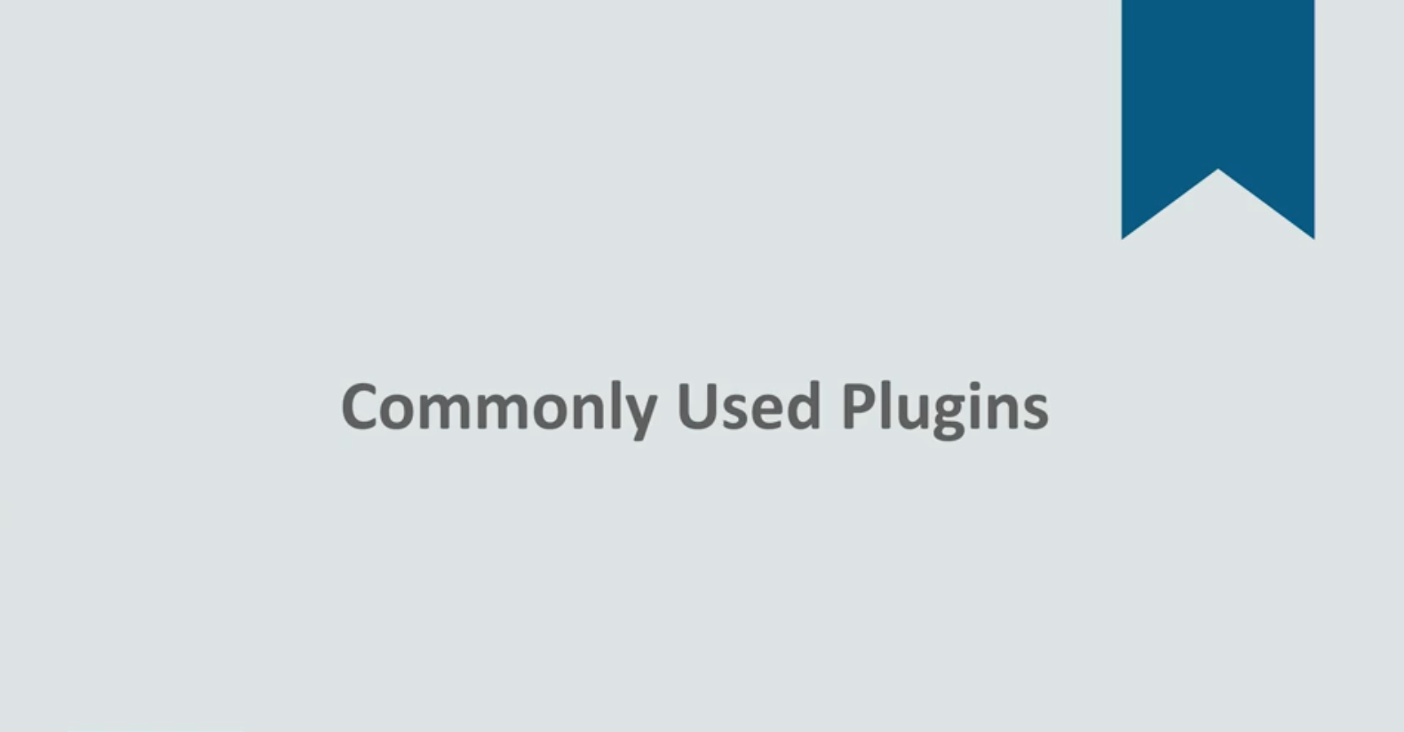
Demo

Slide 10
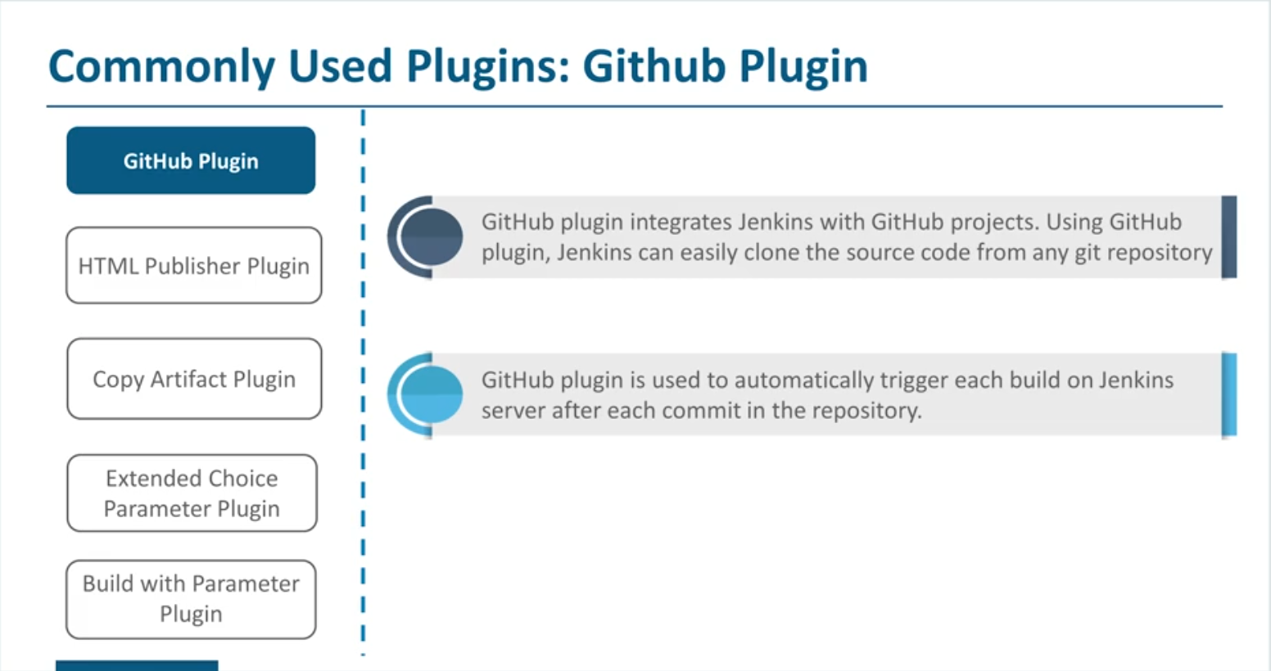

Slide 11
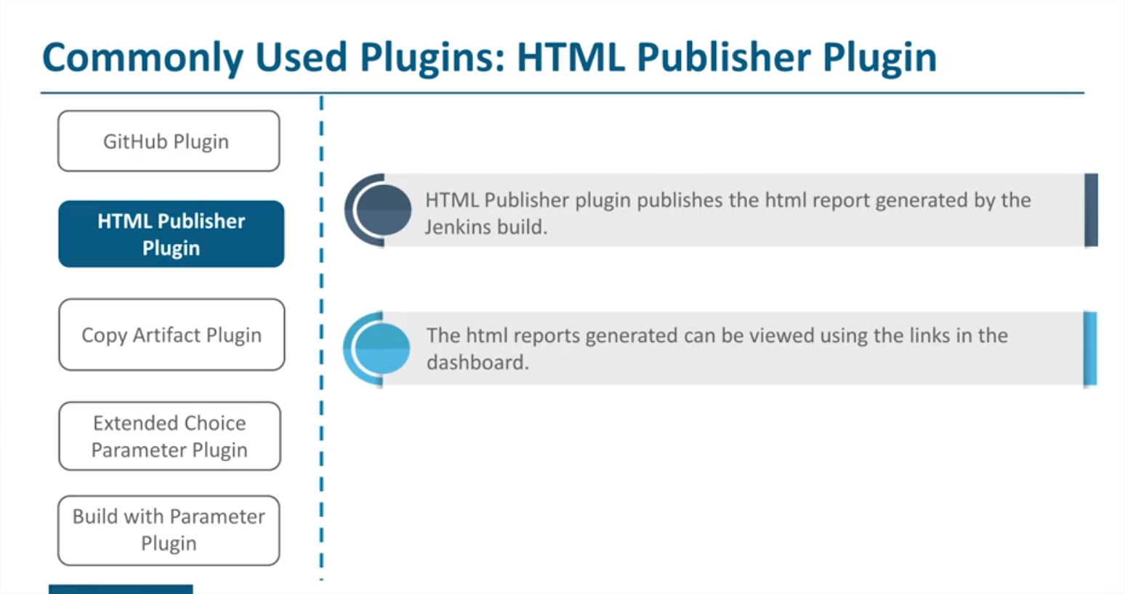

Slide 12
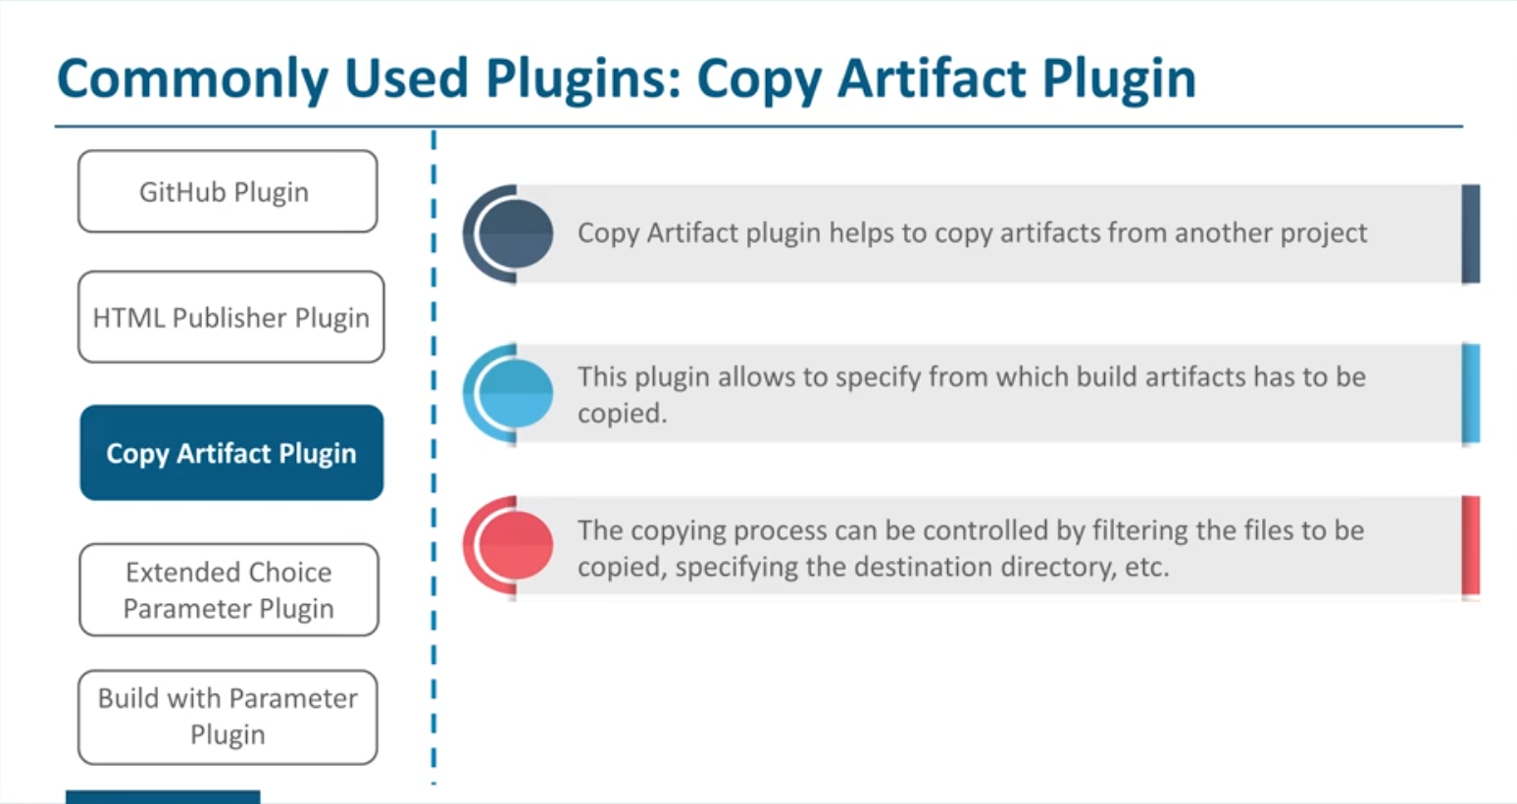

Slide 13
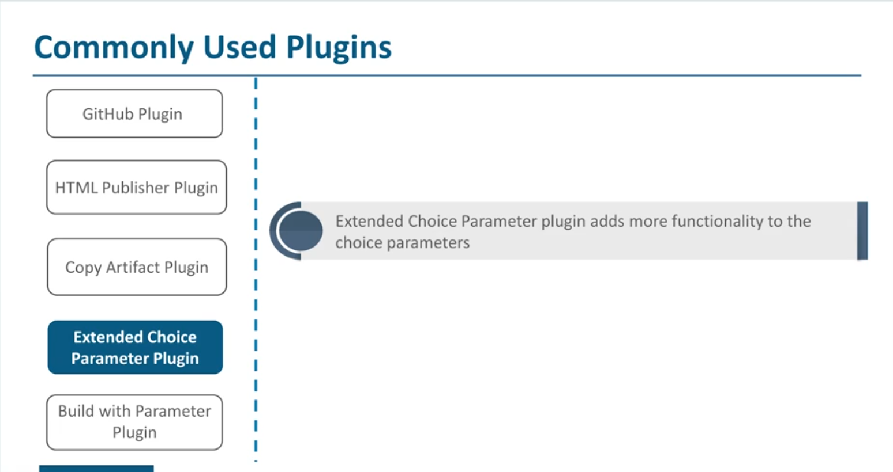

Slide 14
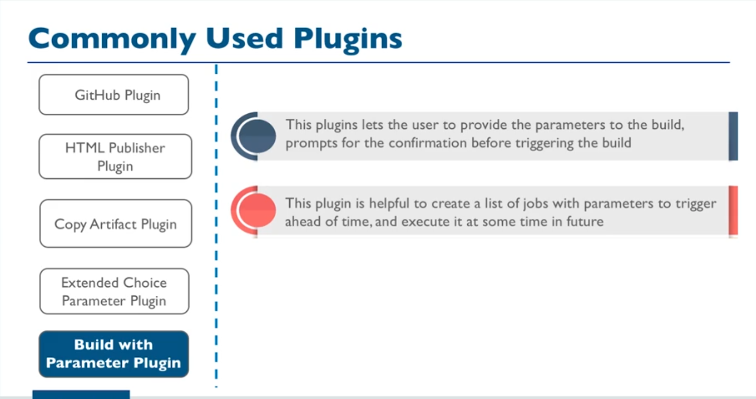

Slide 15
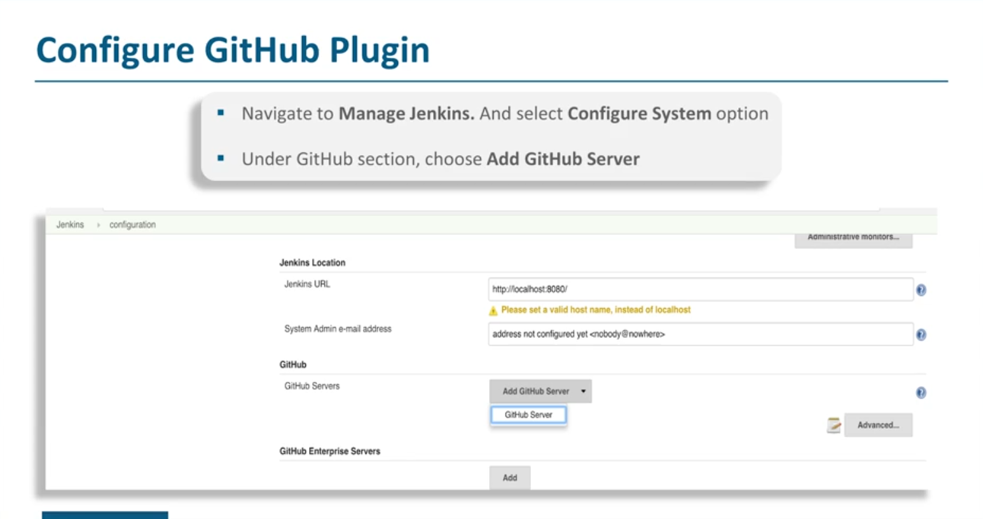

Slide 16
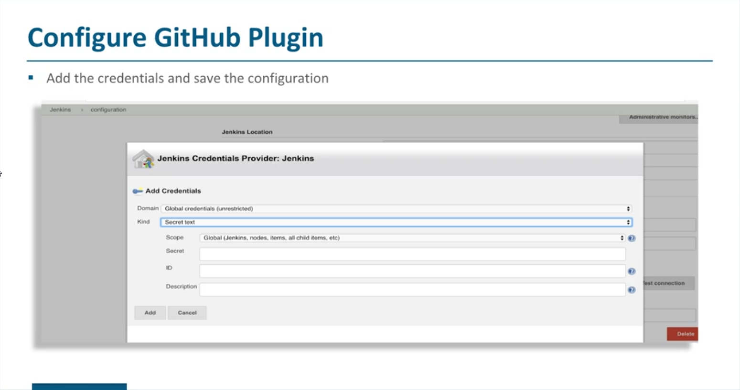

Slide 17
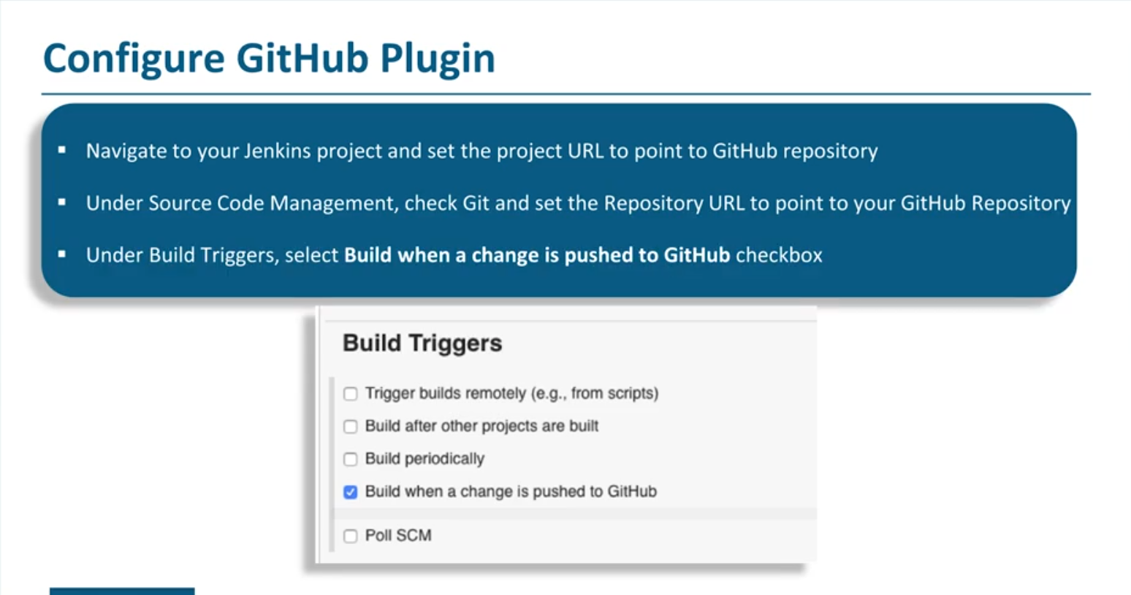

Slide 18
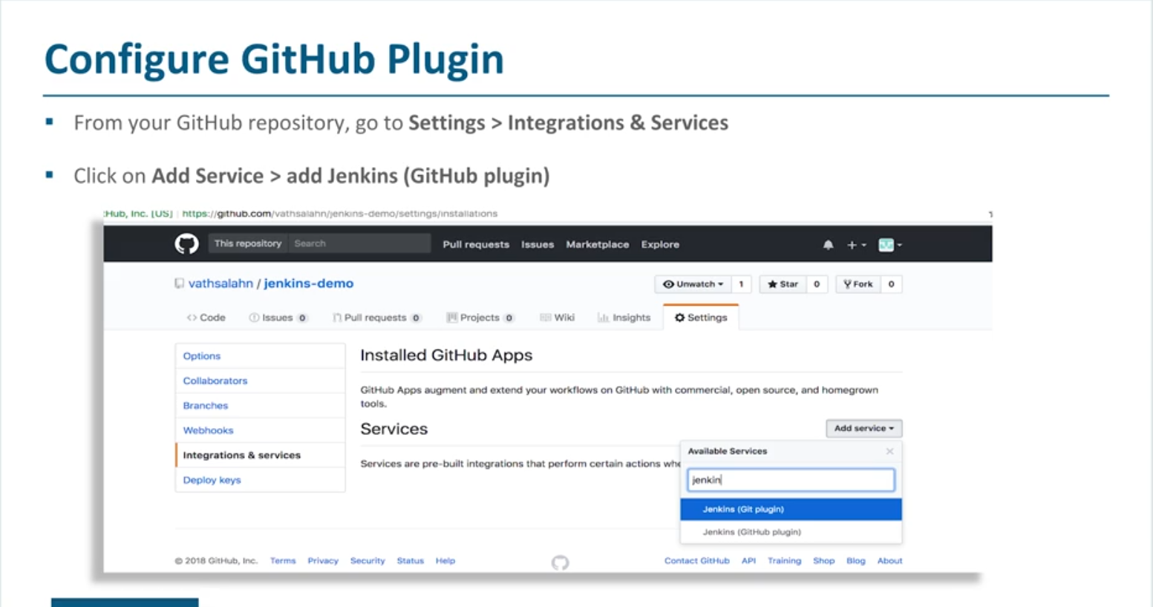

Slide 19
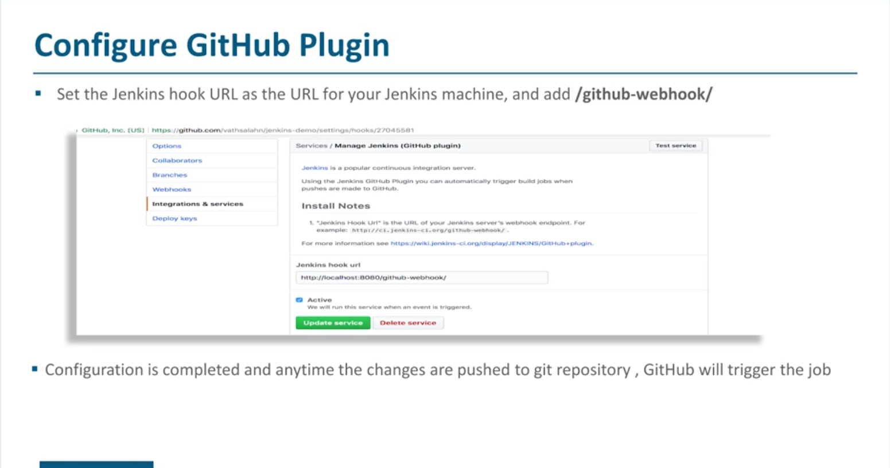

Slide 20
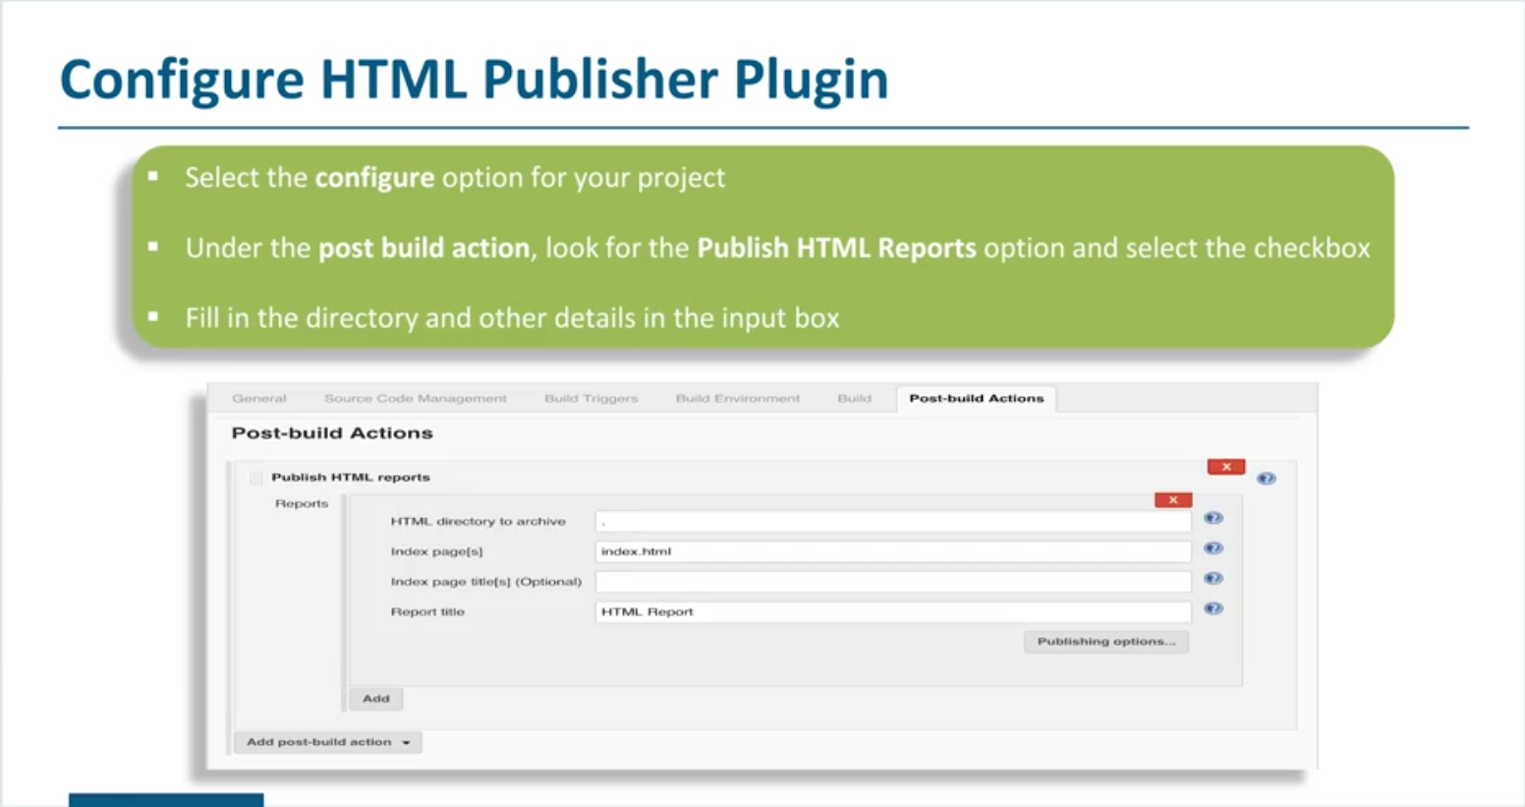

Slide 21
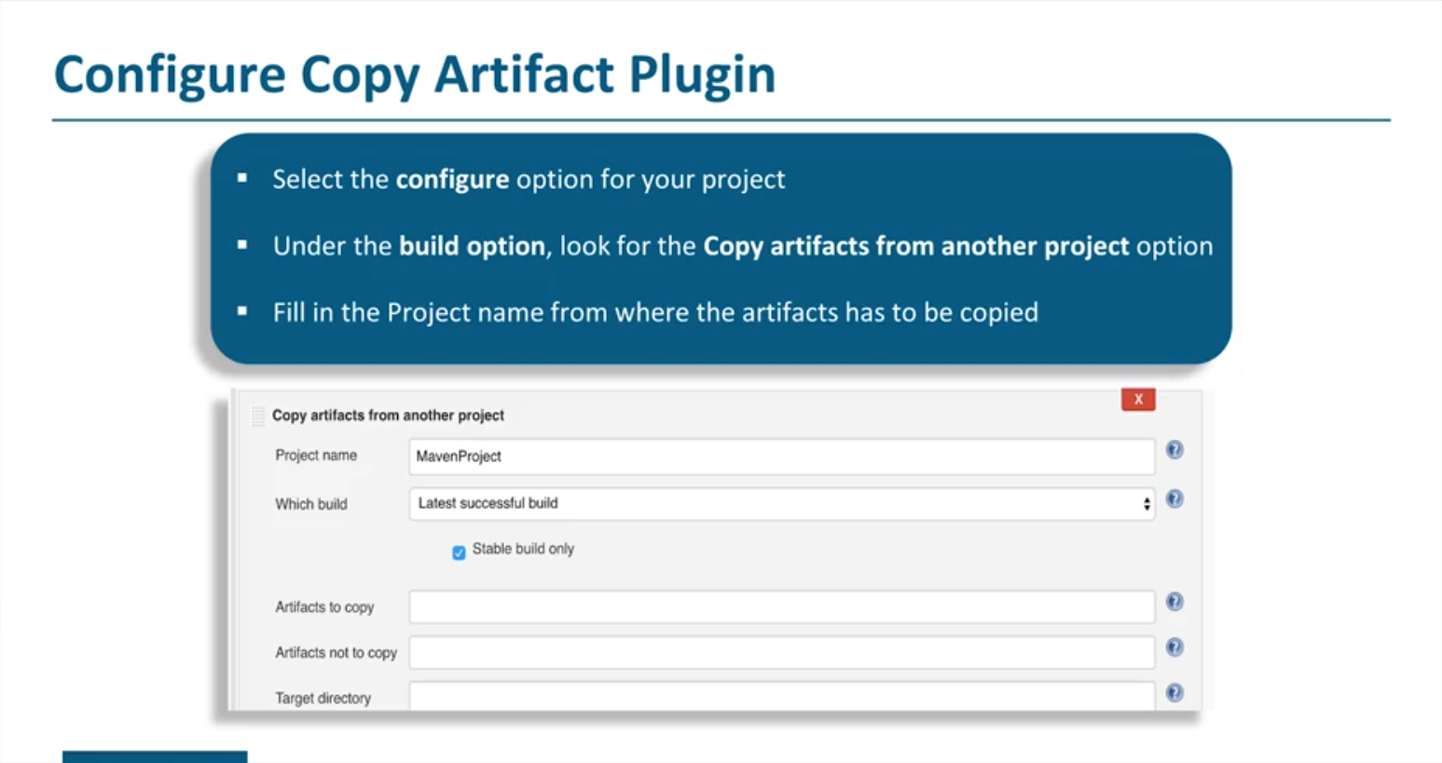

Slide 22
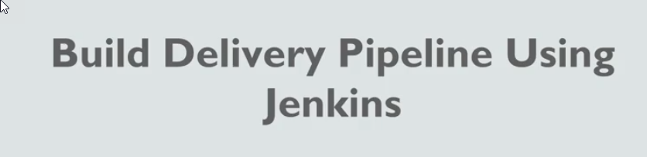

Slide 23
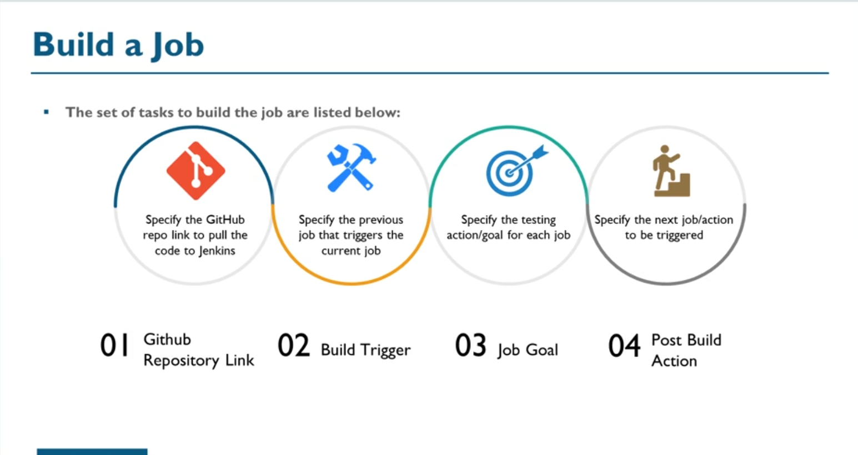

Slide 24
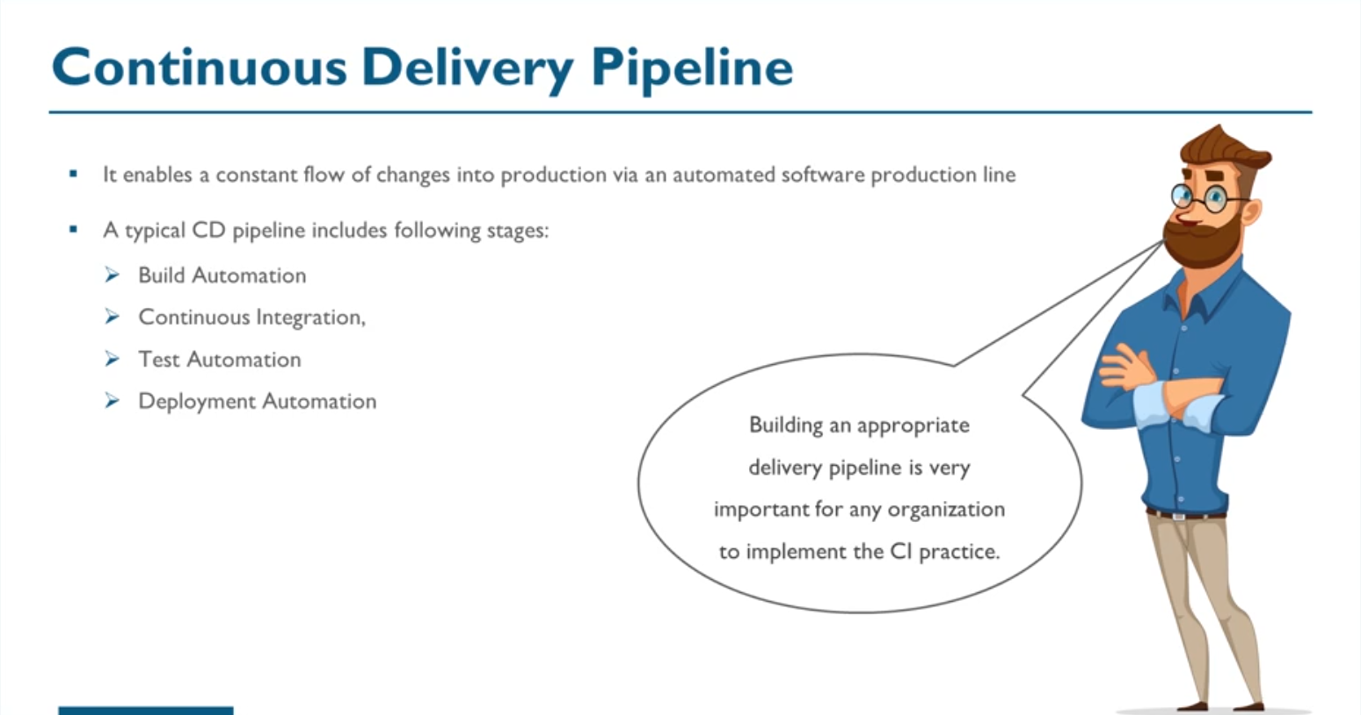

Slide 25
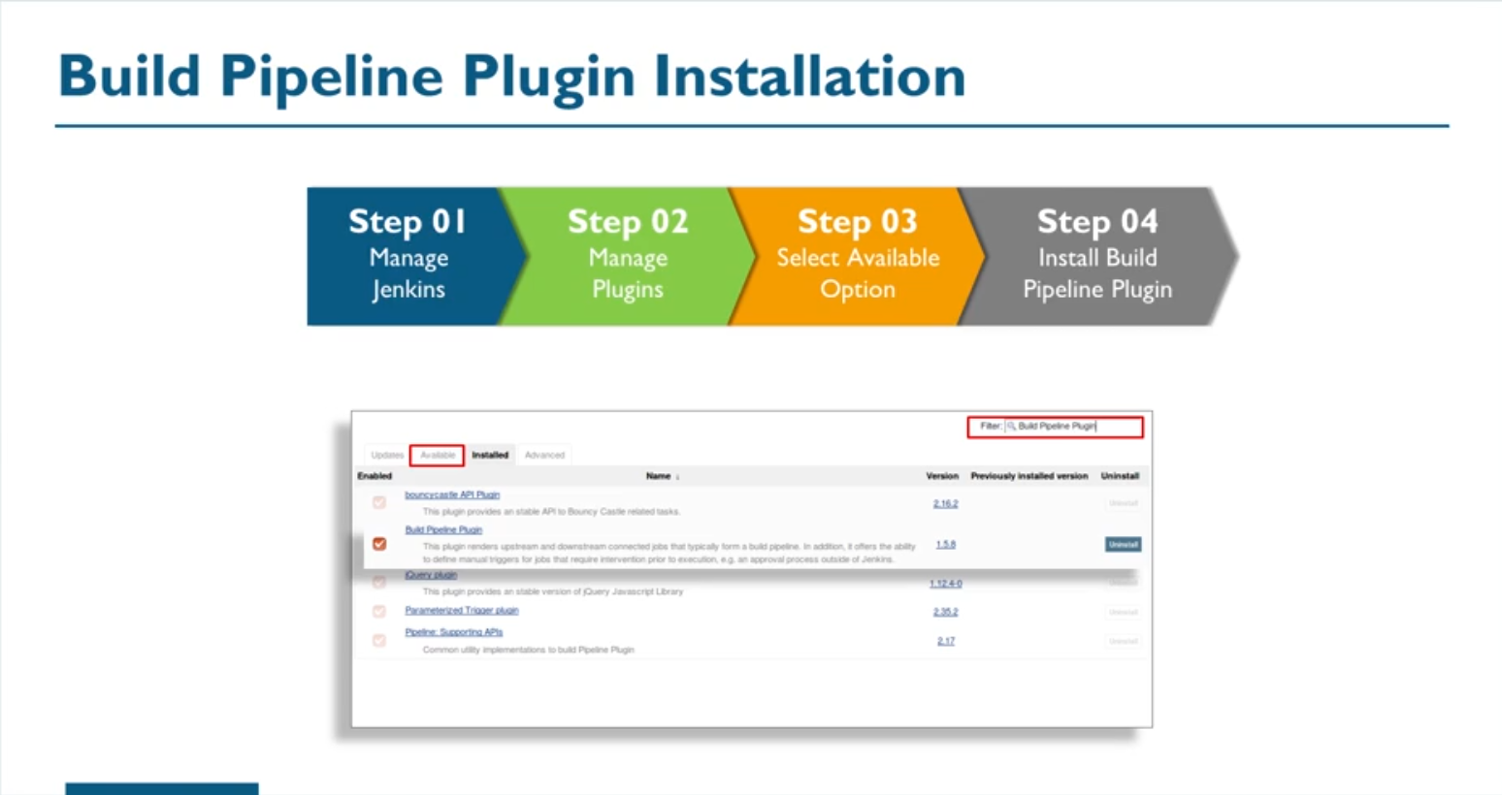

Slide 26
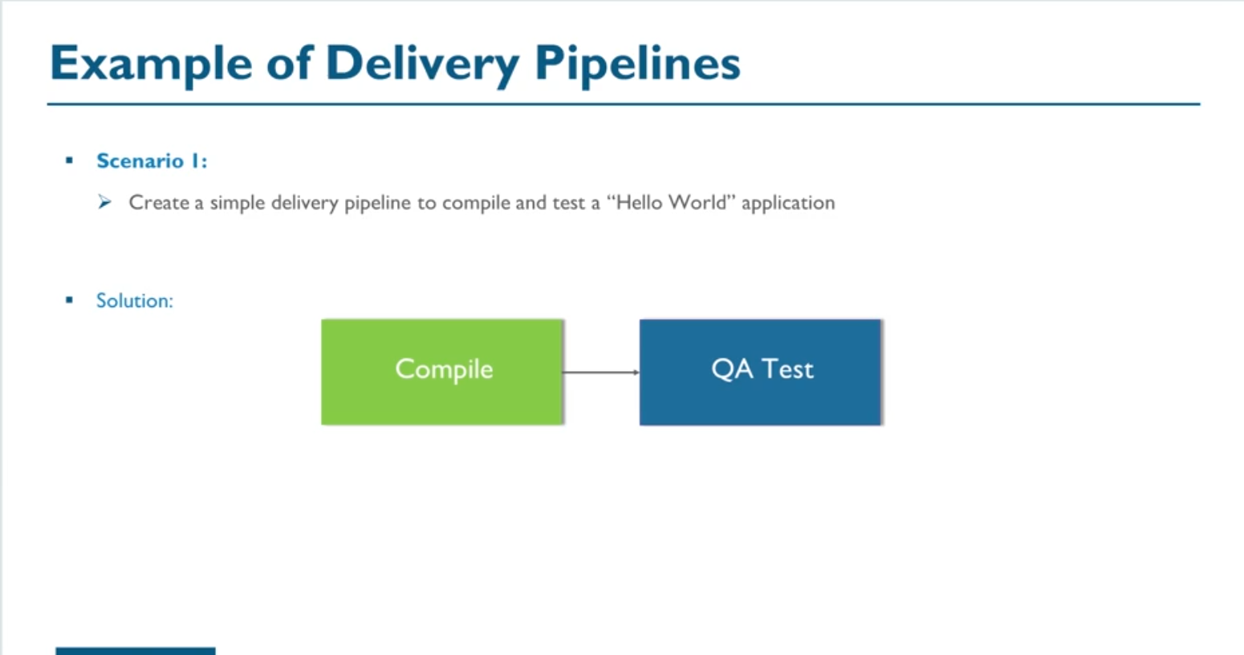

Slide 27
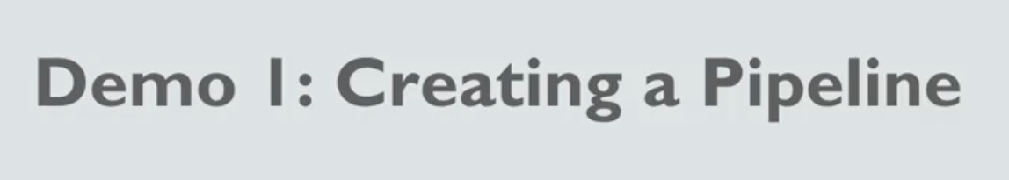

Slide 28
Demo
Jenkins Home
New Item
Freestyle Project
Edureka-git/devopsclass-codes.git
Source Code Management
Git
Repo URL
Build
Top Lavel mvn Target
Maven Version
Goals – compile
Save
New Item
Freestyle Project – QA test
Source Code Mgmt
Git
Build
Maven
Compilr

Slide 29
DEvCompile
Configure
Post Build Action
Build
Build Other Projecy
Project – QA Test
Install Build Pipeline Plugin
New View- DevOps Pipeline
Execute the Build Pipeline

Slide 30
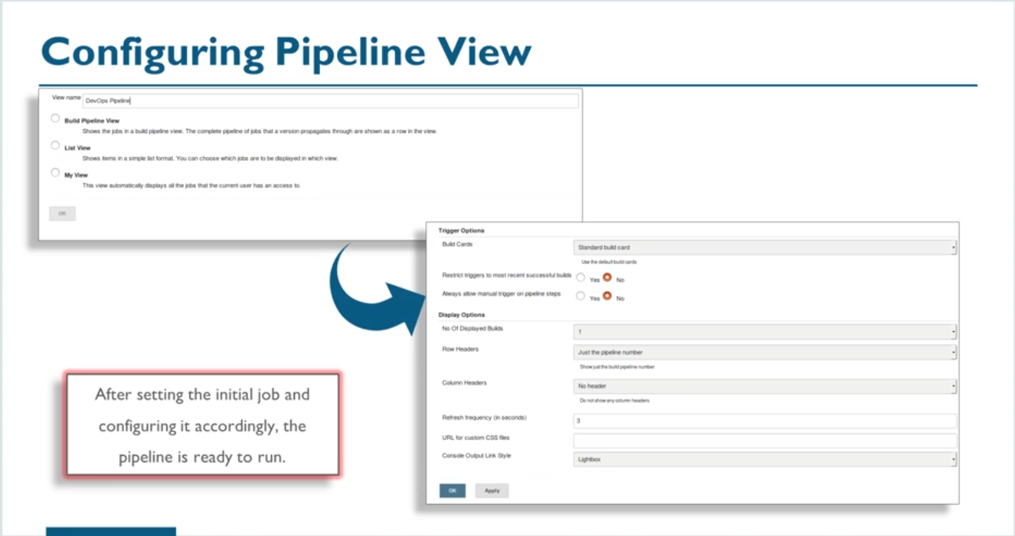

Slide 31
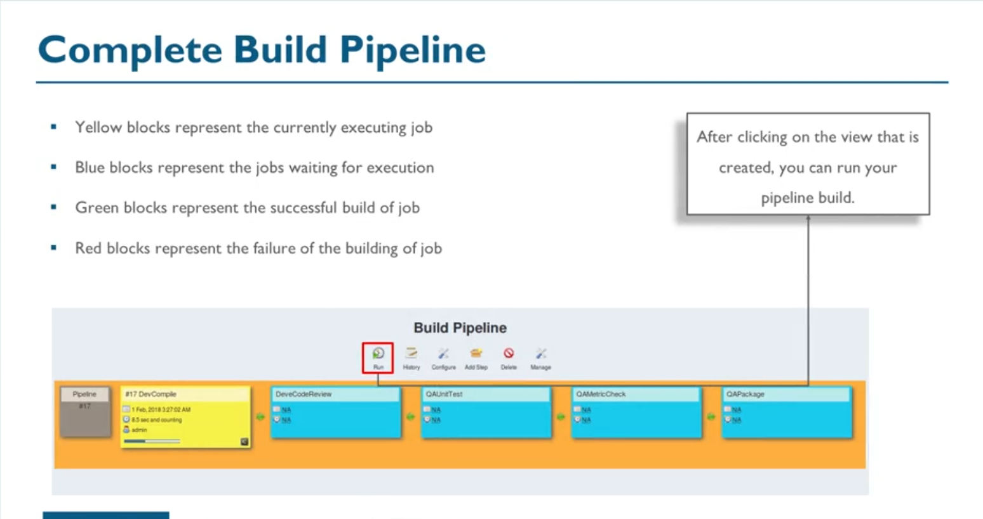

Slide 32
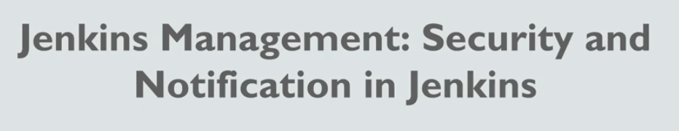

Slide 33
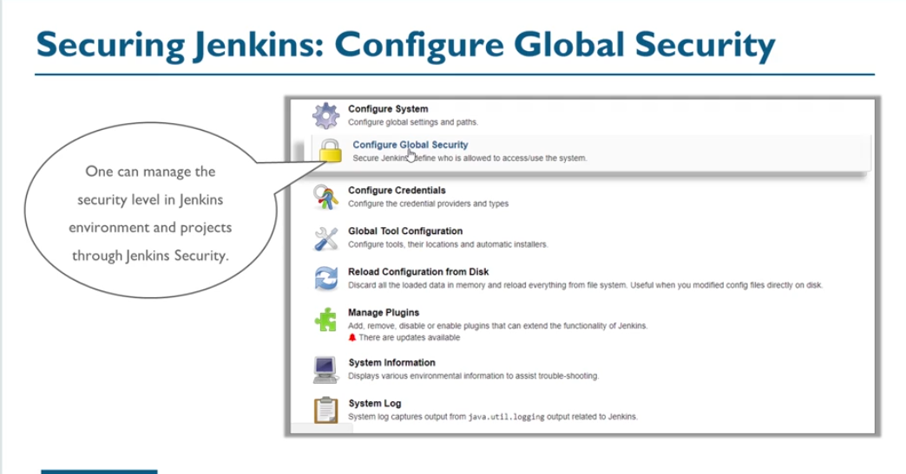

Slide 34
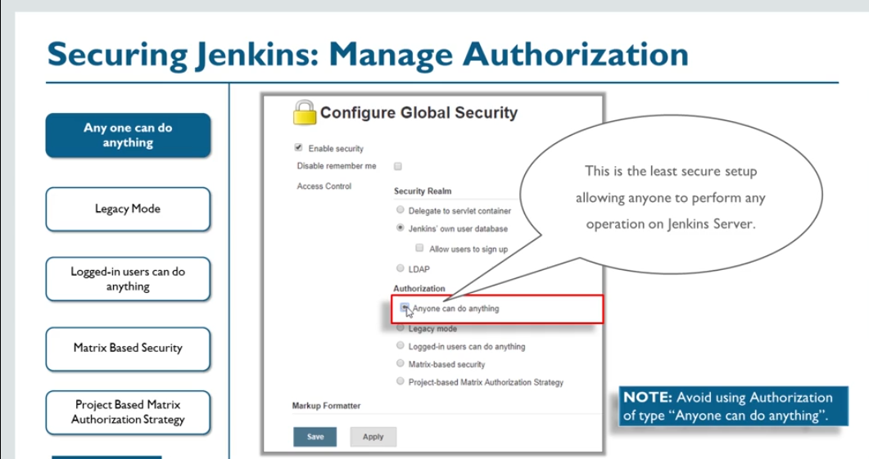

Slide 35
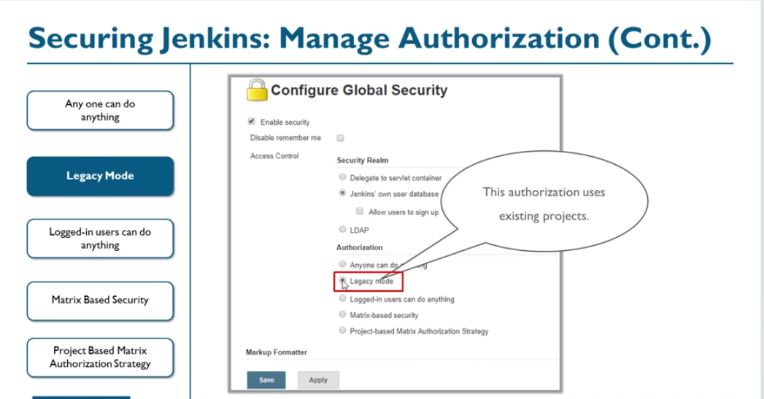

Slide 36
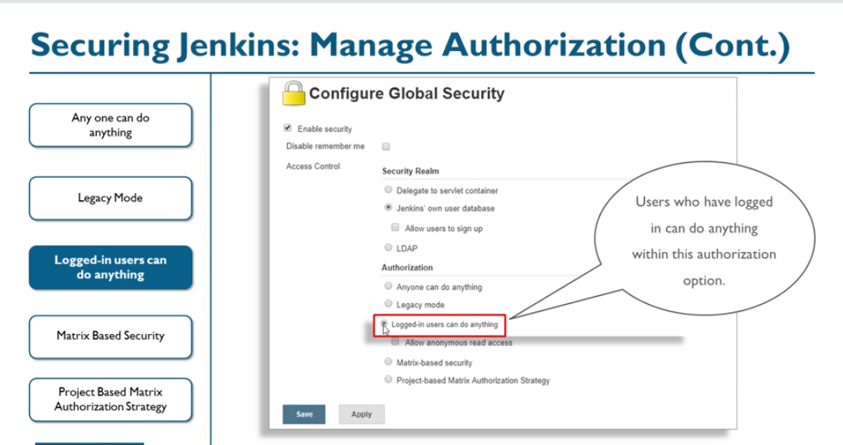

Slide 37
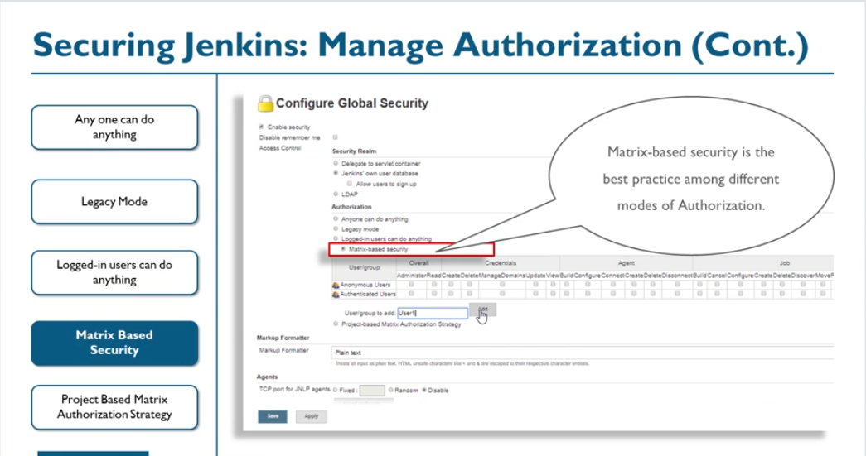

Slide 38
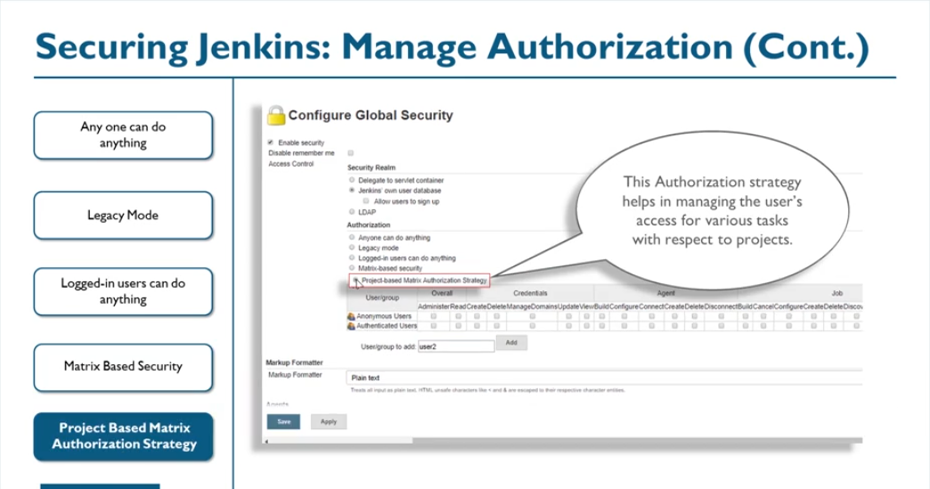

Slide 39
Configure Global Security
Authorization
Auditing in Jenkins
Install Audit Trail Plugin
Global Configuration

Slide 40
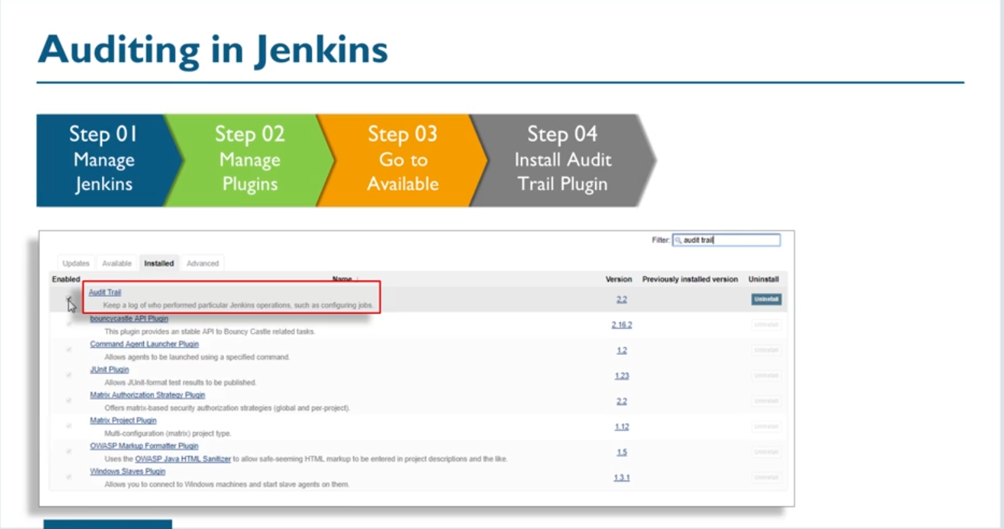

Slide 41
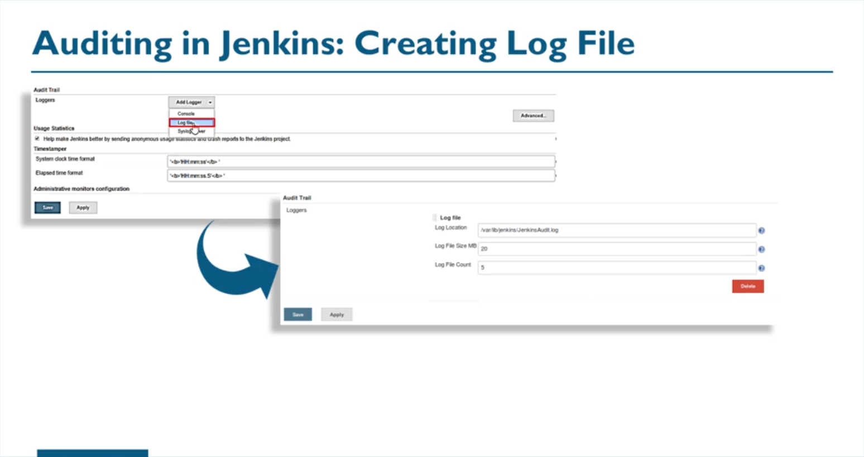

Slide 42
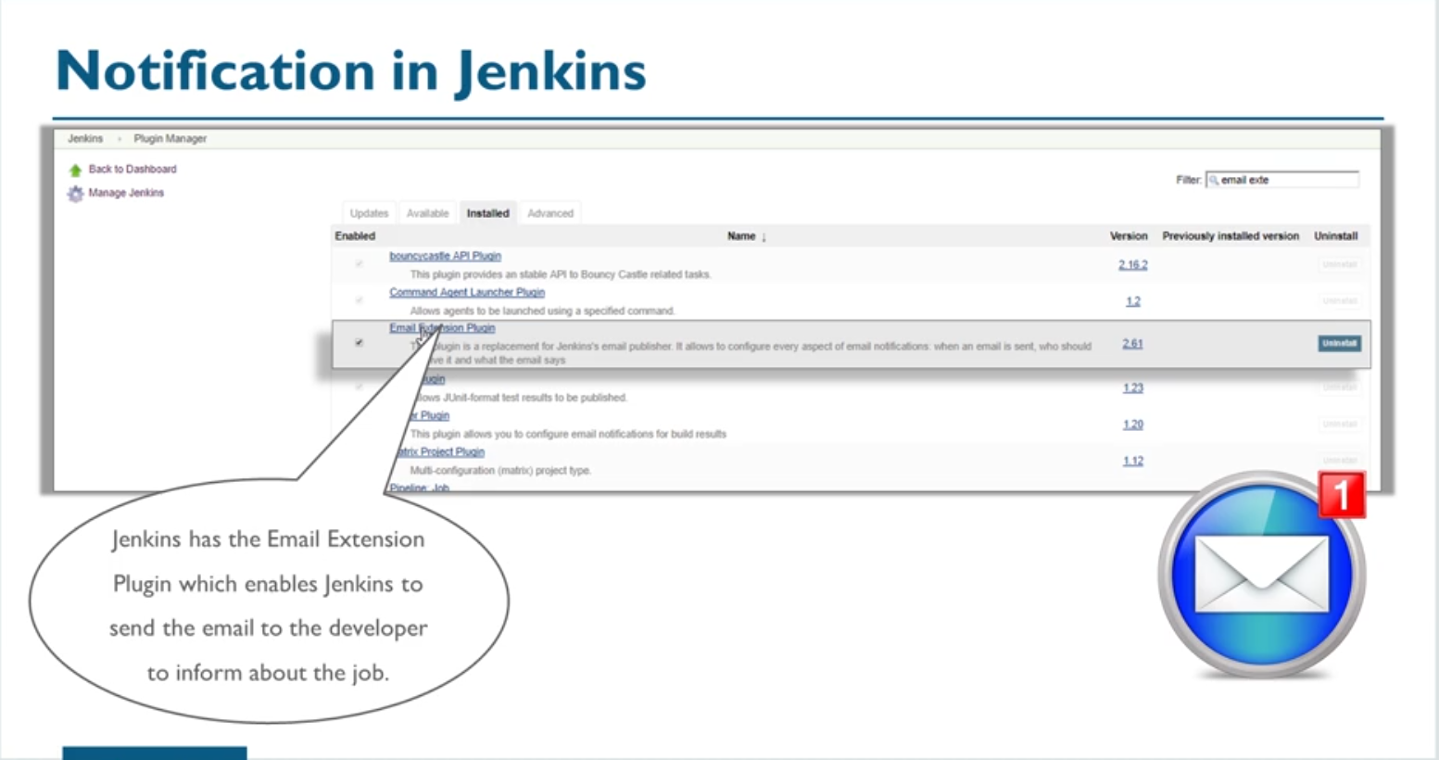

Slide 43
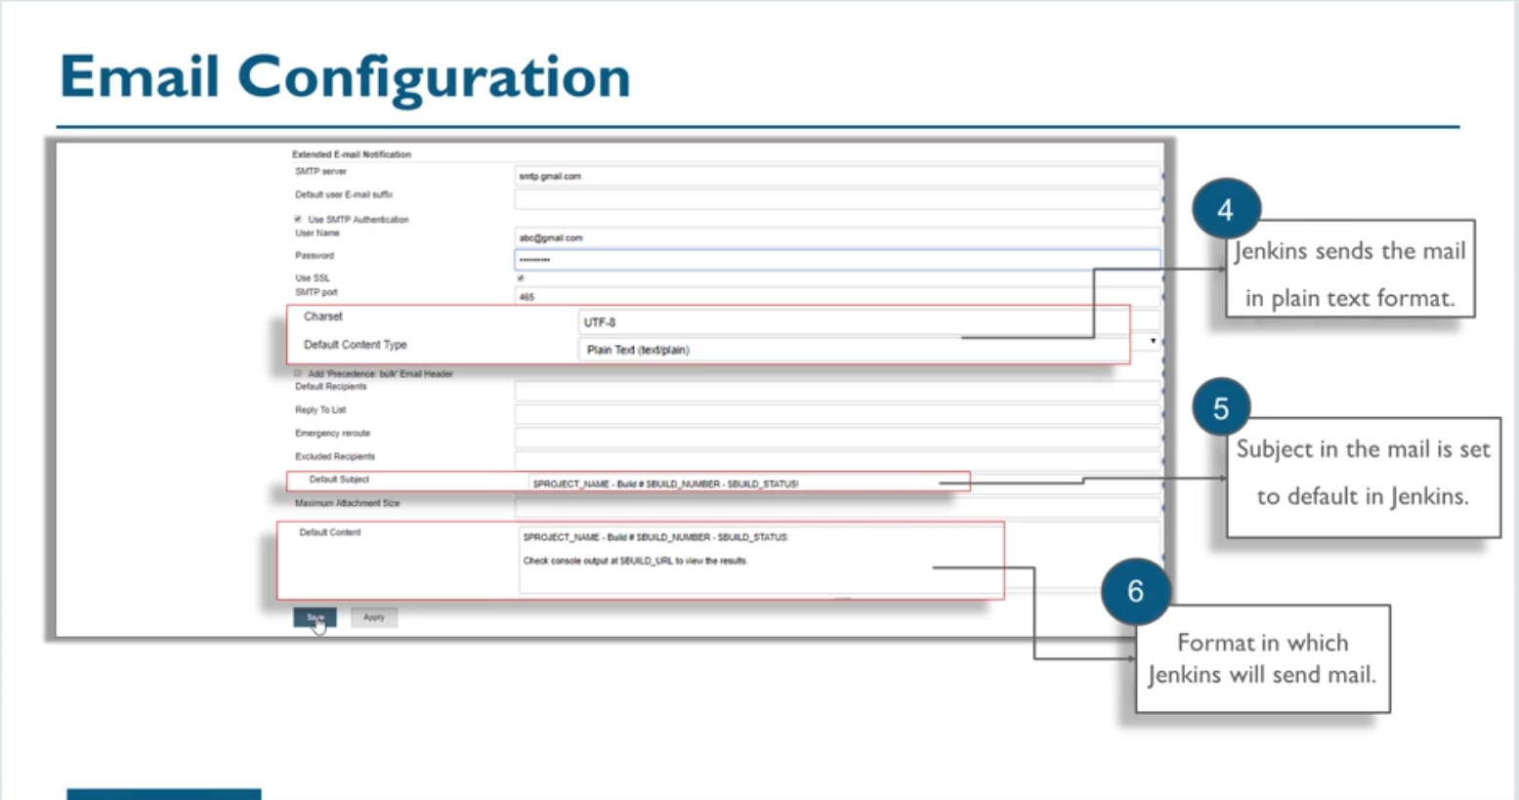

Slide 44
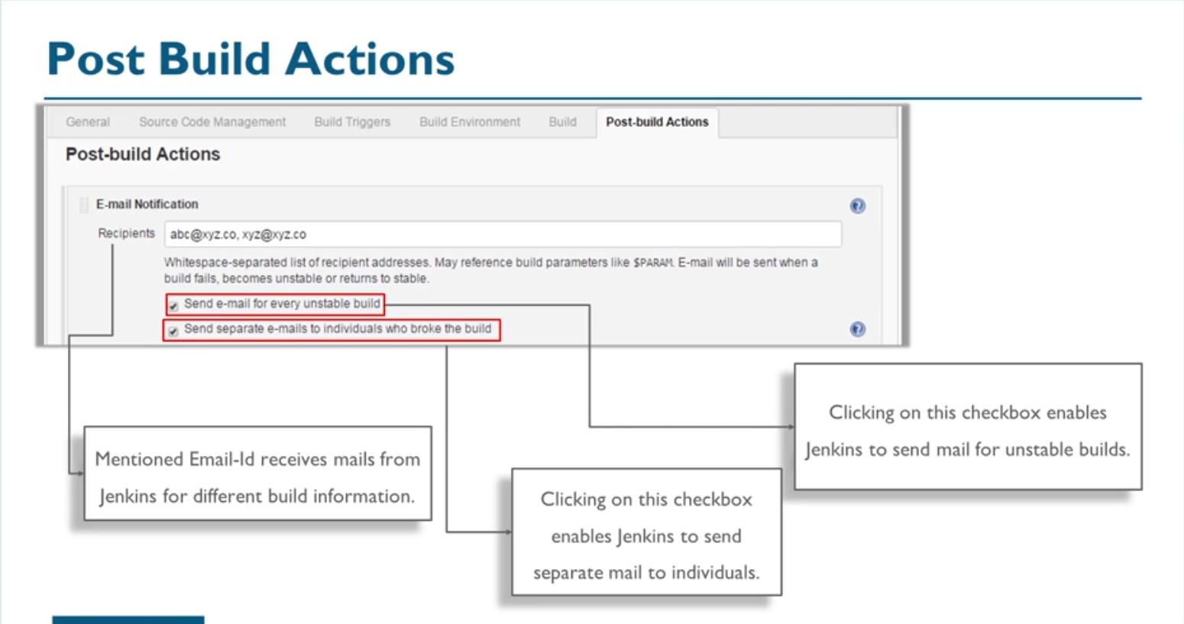

Slide 45
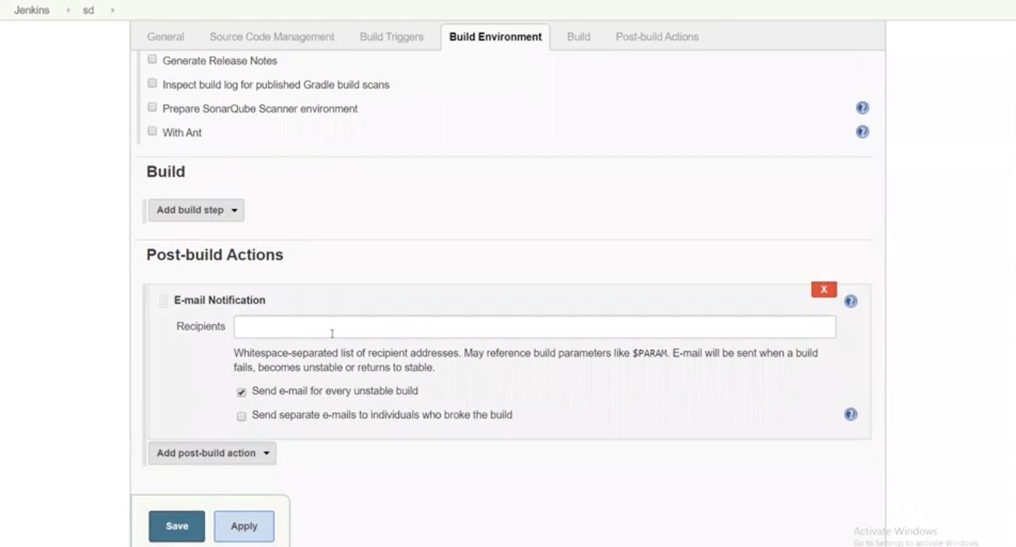

Slide 51
